Slide 1
English
Unit 1 – My World
WALT: Plan, write, edit and proofread short texts, with little or no support.

Slide 2



WALT: Plan, write, edit and proofread short texts, with little or no support.
I can use my plan to write about an inspirational person.
I can include a range of connectives in my writing.
I can make my writing interesting for the reader using features from the SC.

Slide 3
Retrieval Practice – Get your plans out from last lesson. Tell your partner who your inspirational person is and what makes them inspirational.
WALT: Plan, write, edit and proofread short texts, with little or no support.

Slide 4
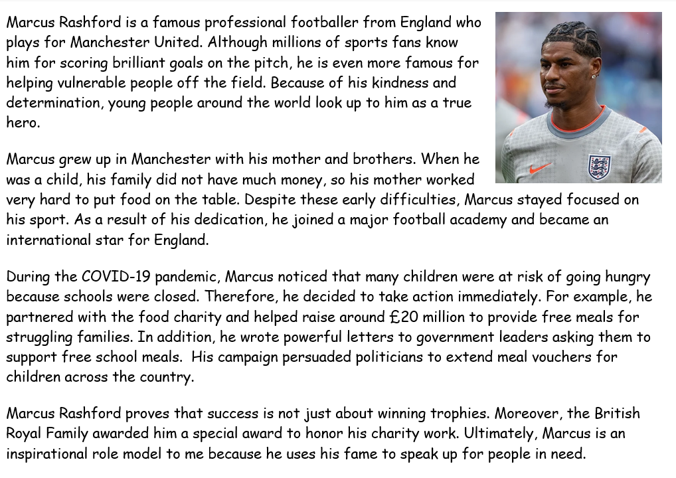
WALT: Plan, write, edit and proofread short texts, with little or no support.

Slide 5
WALT: Plan, write, edit and proofread short texts, with little or no support.
Using your plan, you are going to start writing your explanation piece.
Modelling

Slide 6
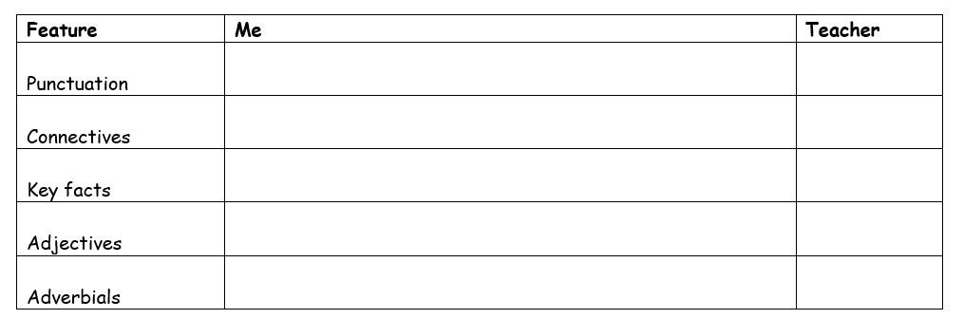
WALT: Plan, write, edit and proofread short texts, with little or no support.
When you’re writing, make sure to use the success criteria to ensure you are including all of the features.
If you’ve finished, read through your work and check for any mistakes.

Slide 7
WALT: Plan, write, edit and proofread short texts, with little or no support.
I can use my plan to write about an inspirational person.
I can include a range of connectives in my writing.
I can make my writing interesting for the reader using features from the SC.

